Slide 1
Dynamic Focus+Context for
Volume Rendering
Peter Sikachev, Peter Rautek,
Stefan Bruckner and Eduard Gröller

Slide 2
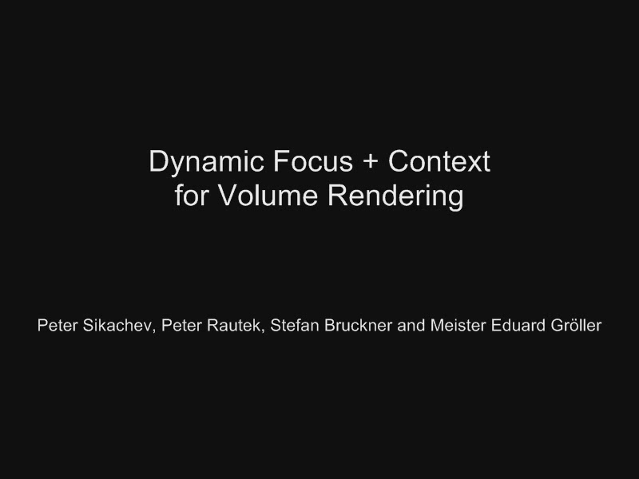
Video Demonstration

